Slide 1
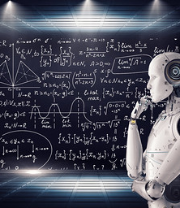
Deep Learning with Python Diffusion Models
Edgar Lobaton, Ph.D.
Electrical & Computer Engr. Dept.
North Carolina State University

Slide 2
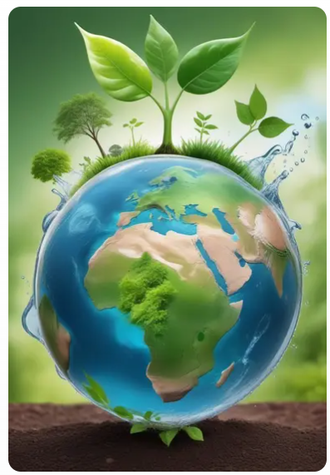
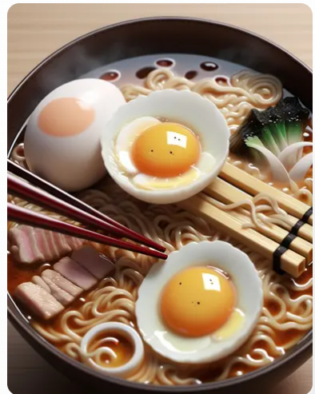
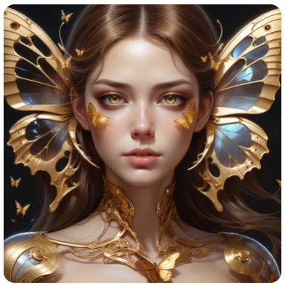

Image Generation
Stable Diffusion (Prompt $→$ Image)
Beautiful Cyborg with Brown Hair
Japanese Ramen
Eco-Friendly

Slide 3
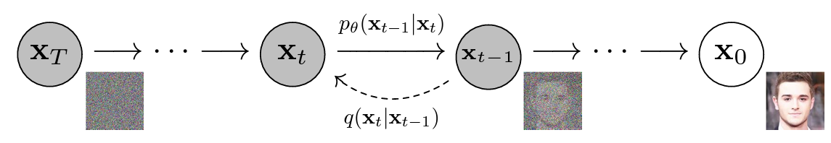

Diffusion Model*
The basic diffusion models aims to generate photorealistic models from noise.
This is done by learning a stochastic process in which noise is added gradually.
The forward process follows $q\left(x_{t} | x_{t−1}\right)=N\left(x_{t};\sqrt{1−β_{t}}⋅x_{t−1},β_{t}I\right)$
The reverse process follows $p_{θ}\left(x_{t−1} | x_{t}\right)=N\left(x_{t−1};μ_{θ}\left(x_{t},t\right), Σ_{θ}\left(x_{t},t\right)\right)$
*Ho, Jonathan, Ajay Jain, and Pieter Abbeel. "Denoising diffusion probabilistic models." Advances in neural information processing systems 33 (2020): 6840-6851.

Slide 4
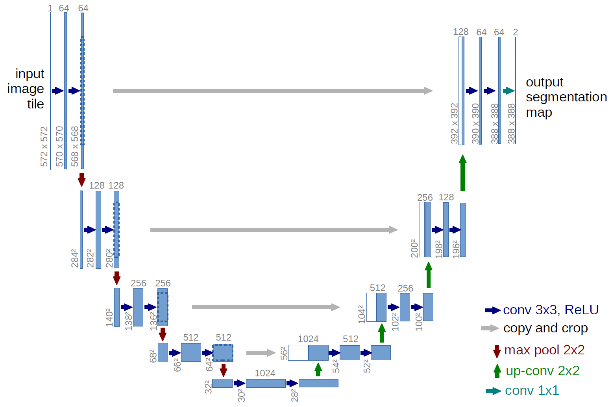

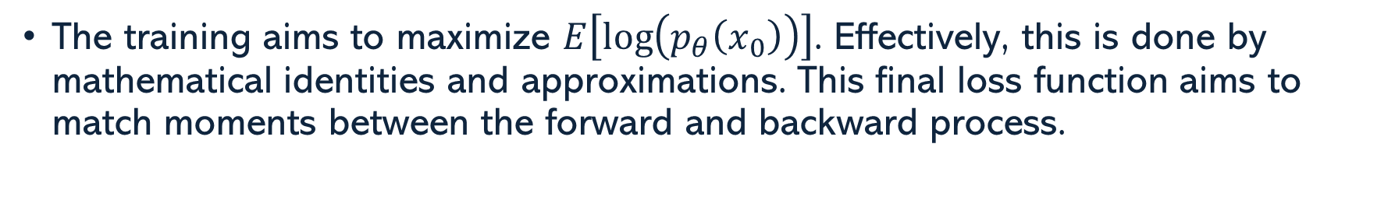
Diffusion Model
*https://lmb.informatik.uni-freiburg.de/people/ronneber/u-net/
The $β_{t}$’s can be hyper-parameters or they can be learned. Often $Σ_{t}=β_{t}I$.
$μ_{θ}(x,t)$ is a DNN. It takes an image as the input and output. An architecture such as a variant of a U-Net is an alternative
The training aims to maximize $E\left[\log\left(p_{θ}\left(x_{0}\right)\right)\right]$. Effectively, this is done by mathematical identities and approximations. This final loss function aims to match moments between the forward and backward process.

Slide 5
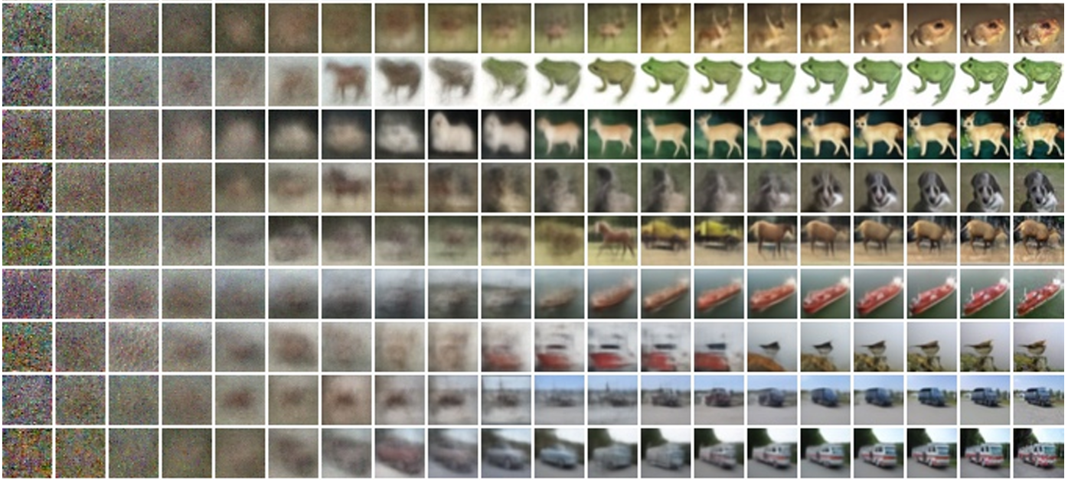
CIFAR10 Progressive Generation

Slide 6



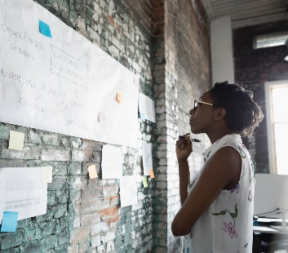
Thank you
Edgar Lobaton
edgar.lobaton@ncsu.edu
https://research.ece.ncsu.edu/aros/

